Slide 1

Team Amazon MEDIABazaar
Sprint Meeting 1
Matthew Gerloff

Slide 2
Mission Statement & Vision
Mission Statement:
Inspire transparency and continuous improvement of the order process to orchestrate a superior experience for our customers, empowerment for our team and aspirational pride for our stakeholders.
Target Audience:
Small and medium sized merchants with limited staff who perform multiple organizational roles and typically purchase in small volumes, but offer a large variety of inventory

Slide 3
Team Roles & Splitting the Work
Team Member | Role | Current Project
Matthew Gerloff | Micro Applications | Brochure
Laxman Chamlagai | Front End Developer | Website
Rodney Layne | Project Manager / Developer | SQL
Tyler Wobschall | Developer | API
Regina Harless | Developer | API
Towana | Micro Applications | Brochure

Slide 4

Brochure Rough Draft

Slide 5
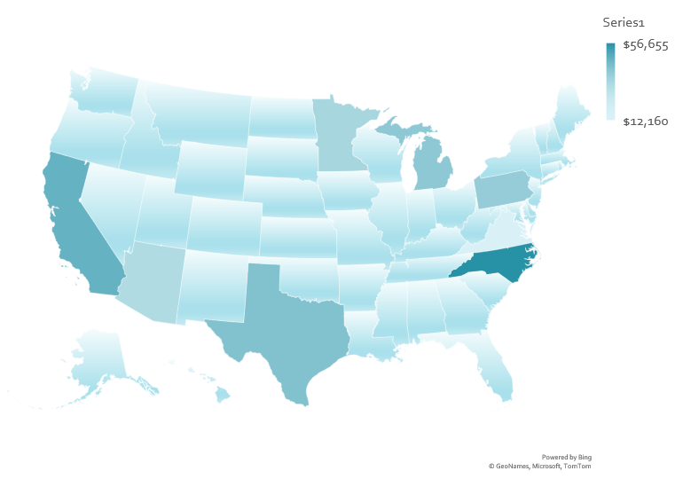
Map Charts Example
Goal: Embed into webpage

